Slide 1
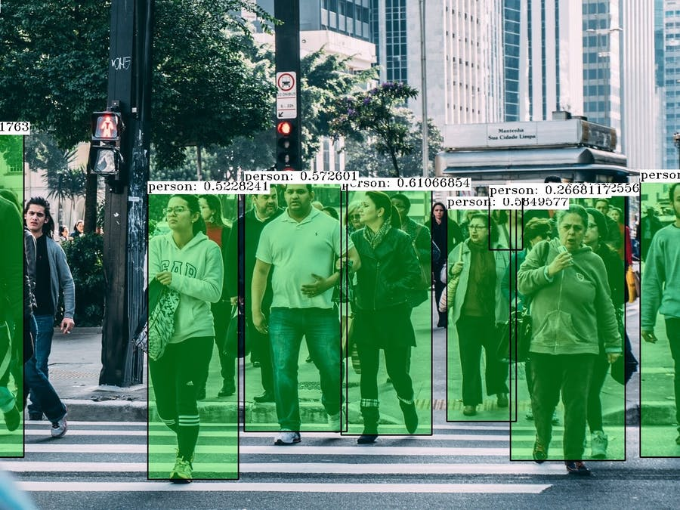
In real life we need to: detect people

Slide 2
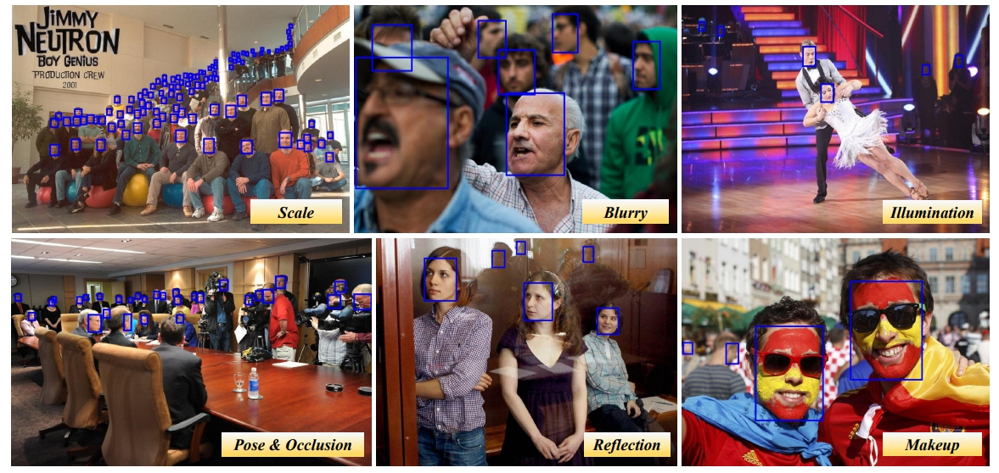
In real life we need to: detect faces

Slide 3

In real life we need to: detect text

Slide 4
In real life we need to: do tracking

Slide 5
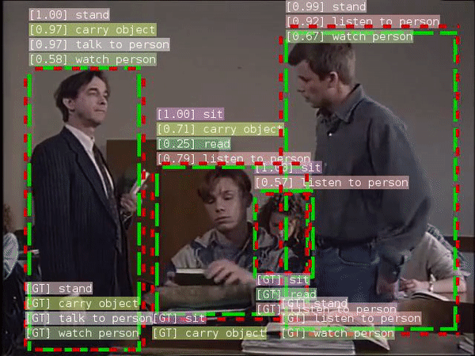
In real life we need to: recognize actions
https://github.com/facebookresearch/SlowFast

Slide 6
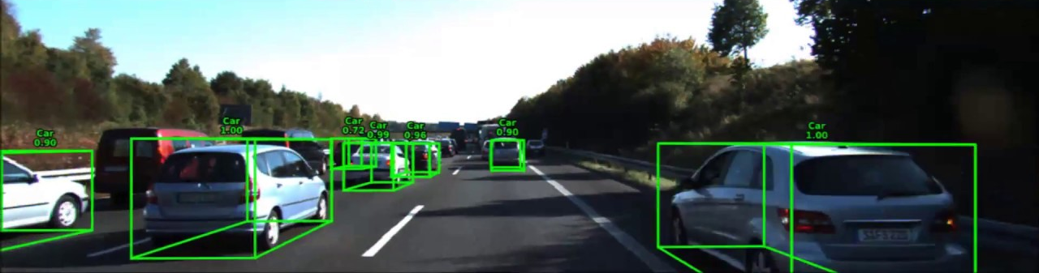
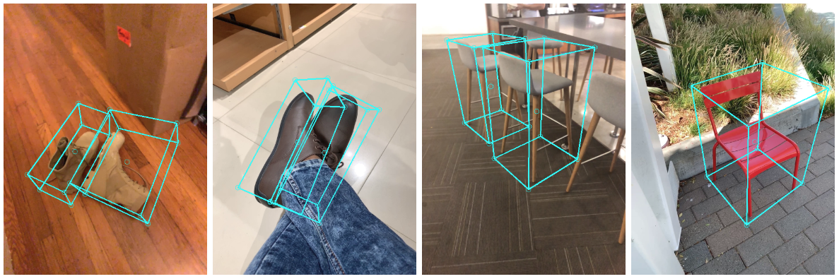
In real life we need to: detect in 3D
https://google.github.io/mediapipe/solutions/objectron

Slide 7
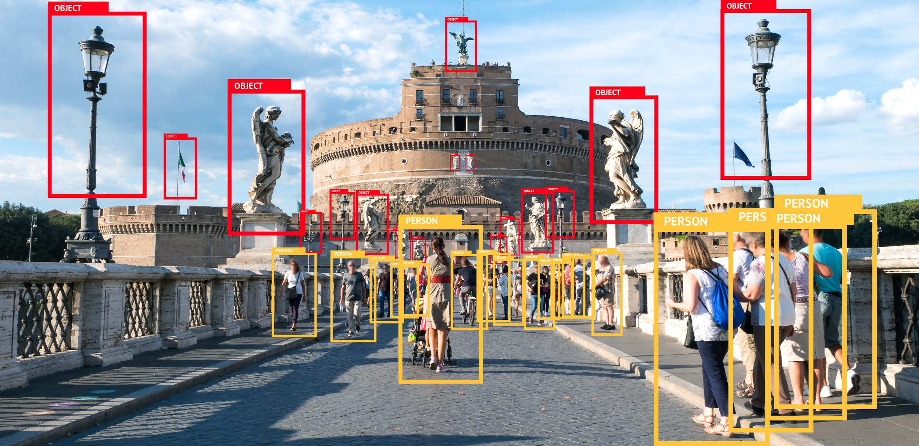
Solutions to these tasks
https://habr.com/ru/company/mipt/blog/458190/

Slide 8
Lecture summary
Classification recap
Object Detection basics
Two-stage (proposal-based) methods
One-stage (single-shot) methods
Modern approaches & tasks

